Slide 1

SIEBEL CRM IP 2019
NEW FEATURES & RELEASE UPDATES

Slide 2
Purpose
Shows the features and enhancements included in Oracle Siebel CRM Release Updates also new features of Siebel IP 2019 version. Its intended purpose is to help assess the business benefits and for planning the implementation of the new product features.

Slide 3
1
Digital Transformation
2
Customer Experience
3
Innovation
4
Autonomous CRM

Slide 4

Digital Transformation

Slide 5













Digital Transformation
Safe Harbor Statement
The following is intended to outline our general product direction. It is intended for information purposes only, and may not be incorporated into any contract. It is not a commitment to deliver any material, code, or functionality, and should not be relied upon in making purchasing decisions. The development, release, and timing of any features or functionality described for Oracle’s products remains at the sole discretion of Oracle.
Copyright © 2018, Oracle and/or its affiliates. All rights reserved. |
Speed of disruption increasing
Emergence of pervasive AI
Connected devices going mainstream
CRM CX
Mobility
Social
Unlimited infrastructure to scale
Analytics
Big Data AI
Automation
Explosion of de-centralized big data
AR / VR
Cloud
IoT Edge
Blockchain

Slide 6



Oracle Drives Digital Transformation
Industry Solutions
Connected Experience
Marketing
Commerce
Sales
Service
Artificial Intelligence
IoT Analytics
Behavioral Analytics
Marketplace
Connected Intelligence
Connected Data
Master
Transactional
Operational
Sensor
Behavioral
External
Siebel CRM
Platform
Oracle Cloud Blockchain

Slide 7

Siebel Strategy
Path to Digital Transformation
2013-15
2016
2017
2018
2019
2020
2021
2022
NO
2023 END DATE
Applications Unlimited
Digital: User
Digital: Developer, Administrator
User (Mobile)
Intelligent
Mesh

Slide 8
Digital Transformation with Atlanta 311 Siebel CRM
Siebel IP 2019 Upgrade brings some of the digital transformation’s which can be implemented with Atlanta 311 Siebel CRM System. Below are some,
Alexa with Siebel CRM
Alexa is an intelligent (the artificial kind Voice Assistant) developed by Amazon. You can interact with Alexa via the echo or dot devices from Amazon or via an app.
This technology can help people with disabilities to use speech rather than haptic input.
Enhanced mobility since you don't need to fondle your phone while driving.
The assistant can act as a hub to other IoT devices.
As such, the City envisions supplementing existing service delivery channels (i.e. web, mobile, 311) with this emerging technology to improve the provisioning and accessibility of City services and information for City residents and constituents.

Slide 9
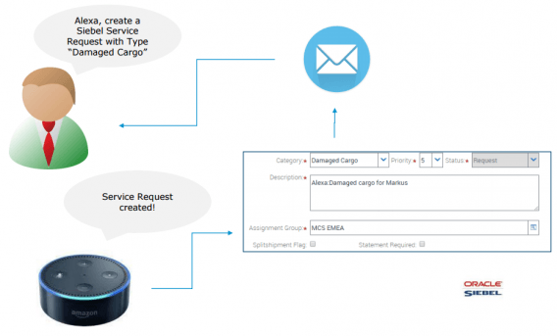
**Alexa, create a Service Request!**
A prototype which allows users to tell Alexa to create records in Siebel CRM.

Slide 10
Oracle Live Experience
Oracle Live Experience Cloud is a SaaS application that enables enterprises to modernize customer experience with digital engagement. A standard Siebel CRM integration with Oracle Live Experience can help drive digital transformation initiatives. By extending the familiar Siebel CRM UI with Oracle Live Experience (LX) it’s possible to deliver new context-aware, modern digital engagement channels including voice, video and screen sharing to their customers.
Key benefits for Atlanta 311:
Improve customer experience
Deliver modern engagement to your customers
Ability to upsell during engagement
Opportunity to differentiate from competitors
Cloud agility & innovation
Leverage existing Siebel CRM investment

Slide 11
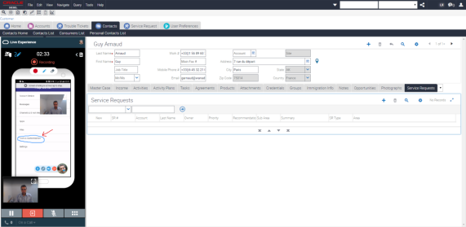
Call Center agents view of Oracle Live Experience integration with Siebel CRM

Slide 12


Customer Experience

Slide 13



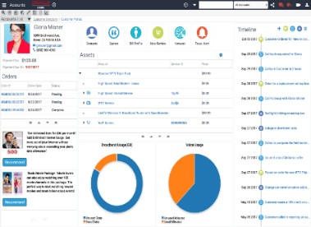


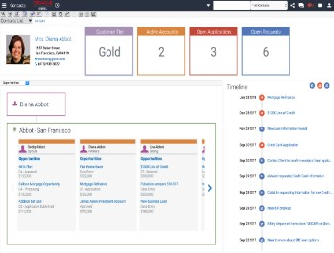
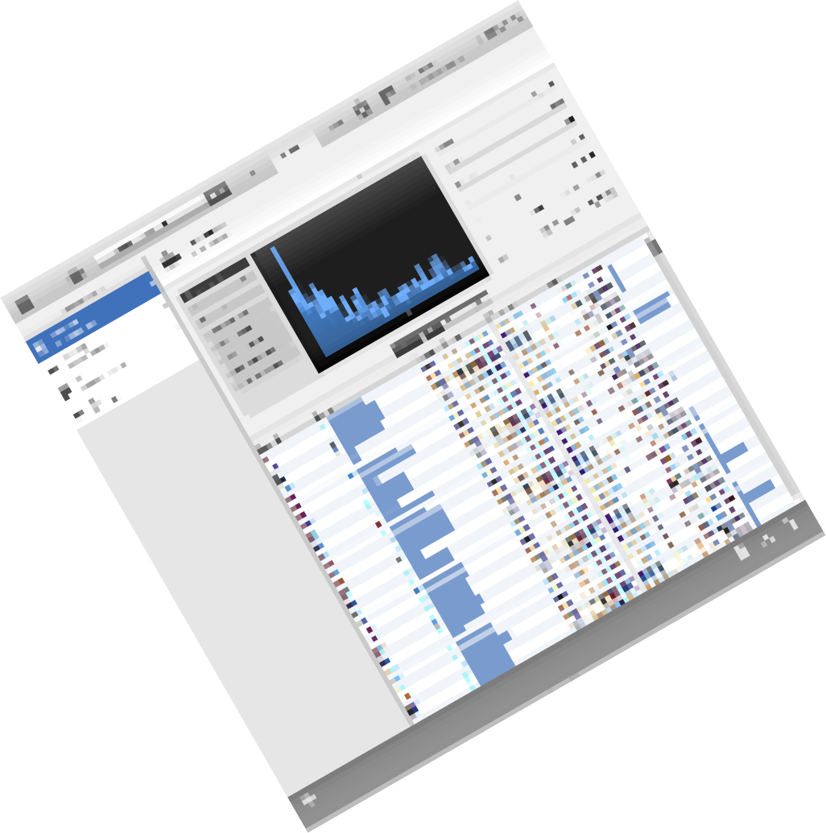

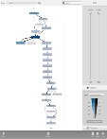
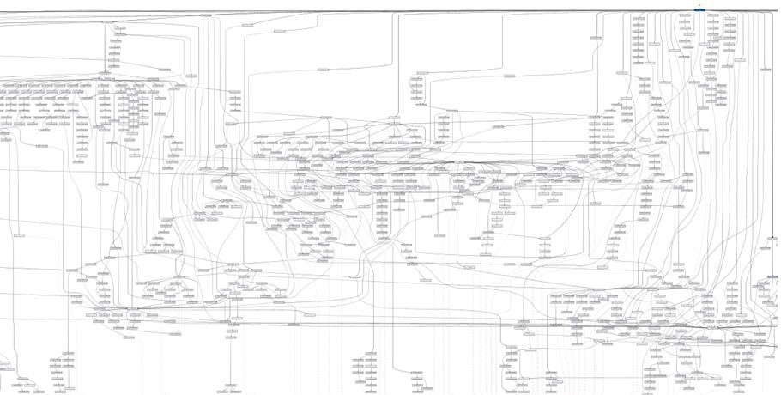
Users: Insights
Data-driven visualization & tasks
Prebuilt charts
Predefined dashboards
Responsive across devices
Chatbots, Voice recognition
Guided user journeys
Usage-based workflow identification
Path to automated tasks

Slide 14

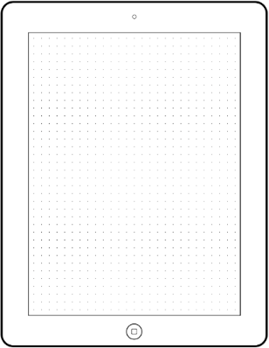
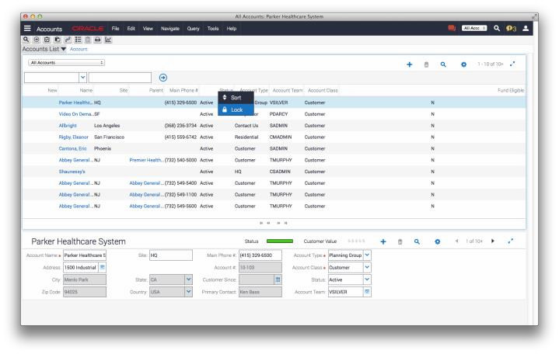
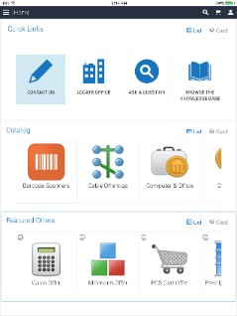
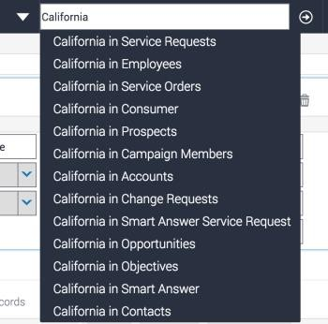
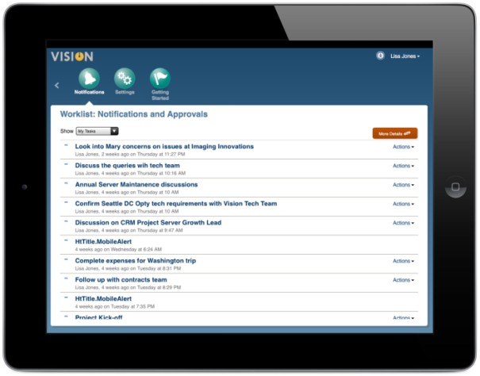


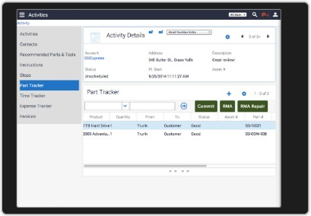
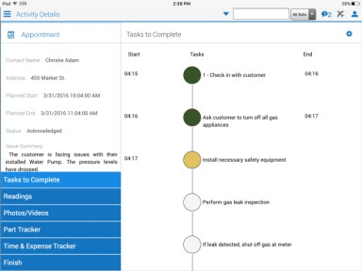

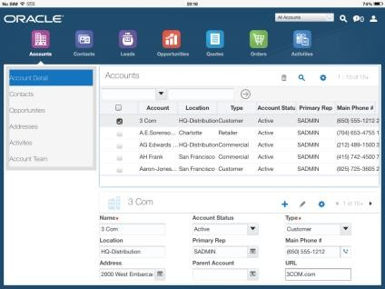
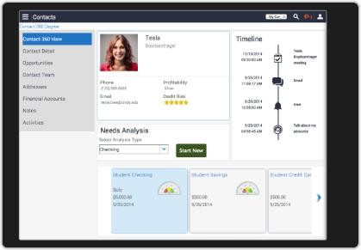
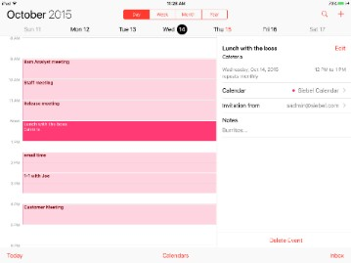
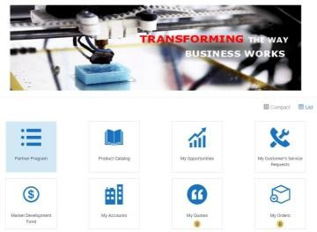
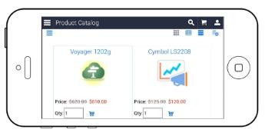
Usability
Customer Experience
Open UI
Mobility
Portals
Continuous improvements and features added to Open UI
Elastic list applets, themes, Outlook, chat integration & advanced Search with In-built Elasticsearch.
Fully extendable, improved performance helping customers deliver innovative solutions to the modern consumer
Mobile apps with seem-less offline
support
Integrated apps for the mobile customer based on their needs using calendar, timeline, barcodes
Purpose built apps for Field Services ,Life Sciences, Consumer Goods & Financial…
New Open UI portals allowing customers to deliver innovative user interactions for their connected customers
Partner portal based on user interactions when and where they need them – eSales, eCustomer and Self-Service

Slide 15
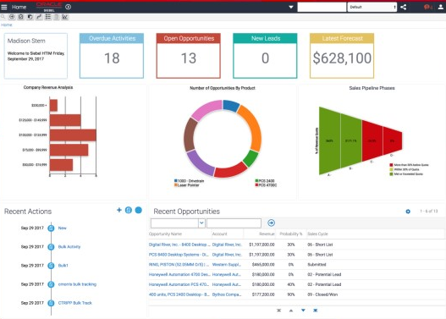
Data Visualization & UI features of Siebel IP 2019:
Atlanta 311 CRM system can be extended to adopt new Data visualization & Open UI features,
Dashboard Auto-Generation
In order to ease the process of generation of dashboards and 360 degree views and to enhance the developer’s experience, Siebel application will have a feature to create dashboard automatically based on predefined rules, templates and by metadata mining.
Dashboard Personalization
Users of the application prefer to see their dashboards with specific set of information and in preferred visualizations. This feature will allow users to customize their dashboards and save their preferences for future use. They would also be able to share their dashboard with others in the community.
Siebel IP 2019 out-of-box Dashboard (Cross Industry)

Slide 16
New Open UI Features that will improve the usability of City CRM users
Automatic availability of Tile and Map visualizations
Capability to load multiple Siebel CRM portlets simultaneously in an external application
Improved UI responsiveness via simultaneous loading within a single UI
Multi-tab browsing of different Views in the same Siebel CRM application open in different tabs
Improved Usability with multiple browser tabs accessing the same Siebel session
UI Right Click and Open - Ability to "Right Click and Open" Siebel navigation links
Improvement in UX for editing of hierarchies, including those involving multiple Object styles, across Siebel functional areas
Contact Photo Web Service
Ability to call an API to associate a photo with a Contact.
Reporting for Customer Portals
Enable Oracle BI Publisher reports to be generated on customer facing portal applications via a report icon and supporting views. The reporting capability will be similar to the current reporting functionality. This feature will require an Oracle BI Publisher integration and relevant licenses.

Slide 17
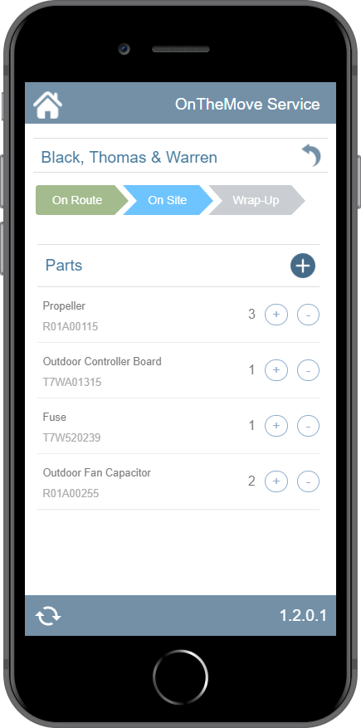
Siebel Mobile
The Siebel Mobile Framework is being enhanced to provide a more consistent user experience whether working online or offline and to ensure the minimum number of gestures (clicks, taps, etc.) is required to complete a task. With the new feature of Siebel Mobile framework the existing Atlanta 311 CRM requirement of Barcode scanning for field service can be extended using the mobile device camera instead of external Barcode scanning device.
Barcode & QR Code scanning using device camera - Siebel Mobile is able to use the built-in camera of the device to scan the QR code to either insert a record or query a record within the Siebel Mobile application. This will streamline the operation of a field technician or a sales rep performing a product audit by using the device camera to easily capture the product information or query a product within the application.

Slide 18
Elasticsearch
Siebel IP 2019 New feature of Elastic search will enable Atlanta 311 for advanced Search functionality eg: KBA Search with autocomplete without calling any API or web service integration.
This include a number of enhancements to Siebel’s Advanced Search functionality:
Integration with Elasticsearch embedded within Siebel (so a third-party REST adapter is not required for Elasticsearch integration).
Siebel CRM will provide a utility to help previous Oracle Secure Enterprise Search customers with the migration of their SES configuration to Elasticsearch.
Support for searching attachment content for Elasticsearch and third-party search engines.
Auto-complete supported out of the box with the embedded Elasticsearch implementation.
Search supported in non-traditional categories (for example Sales Catalog).

Slide 19
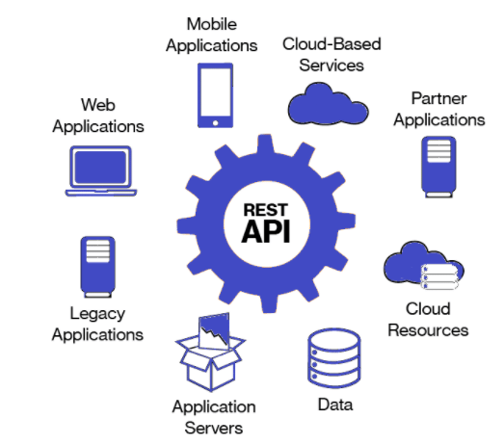
REST API
Atlanta 311 CRM system can integrate with any legacy applications, third party system’s, mobile, cloud services, social media’s etc.. using REST API. With Siebel IP 2019 it supports both Inbound and Outbound REST API calls which enables to easily integrate with Inquesta system. With this enhanced REST API enable’s to call twiiter API’s for integrating Twitter or any social sites within Siebel.
Features of new Siebel CRM REST API:
Ability to Version REST APIs
Support for REST Attachments
Support for single request CRUD of entire Resource Hierarchy – This can facilitate insertion of Business Component records in an entire Business Object in one request.
Support for single request CRUD of multiple resources of same type – This can facilitate insertion of multiple records of a Business Component in one request.
Automation of CRUD APIs - Dynamic IOs
Exposing Siebel Management Console REST APIs
Oauth/Open ID and SAML Integration
Siebel Server Sync for Exchange (SSSE)

Slide 20
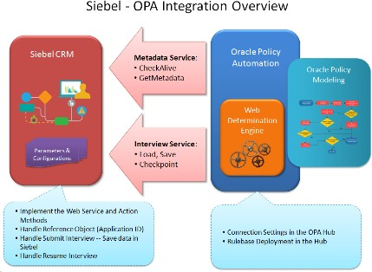

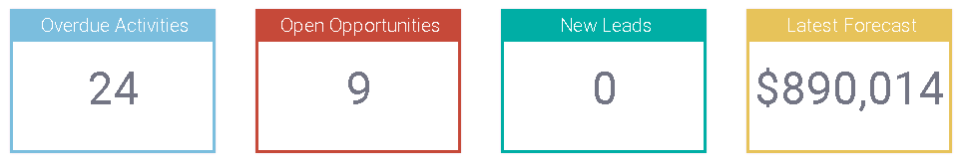

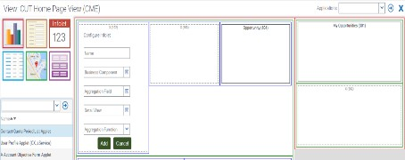
Developers: Automation
Contextual metadata generation
Dynamic metadata alignment
Easy development, customization and deployment
Context-Sensitive Defaults

Slide 21


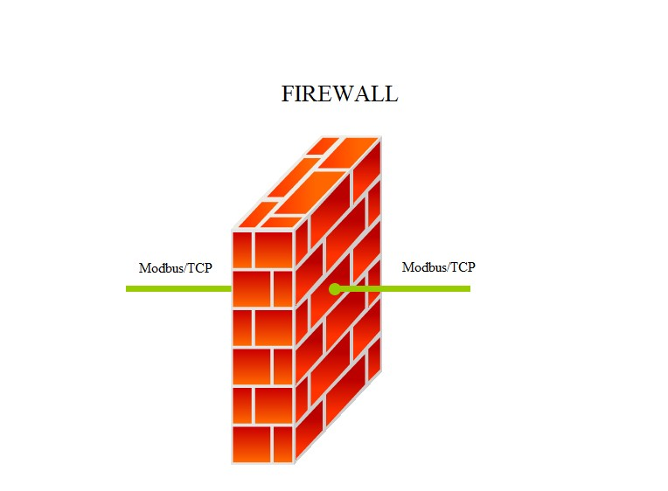







Administrators: Automated Secure Deployment
Migration – Synchronous or Asynchronous
Development
Production
Development
Production
Migration
Siebel 2019
Eliminates dependencies on Source and Target
Organizations have Governance for accepting
migration packages from SI/Vendors
IP-2017
Source and Target servers available/connected
Discovery is dependent on the source/target availability

Slide 22
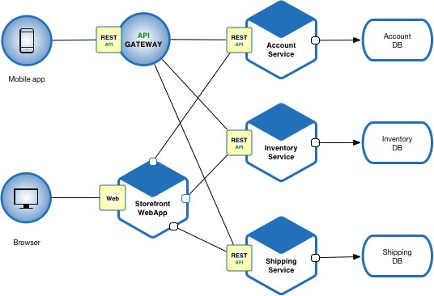
Architects: Elastic deployment
Microservices : Distributing apps, repositories, databases
Today
M apps
1 runtime repository
1 database
AI embedded apps
Future
M apps
N repositories
J Databases
AI/ML embedded apps
16

Slide 23



Innovation
Copyright © 2018, Oracle and/or its affiliates. All rights reserved. |

Slide 24

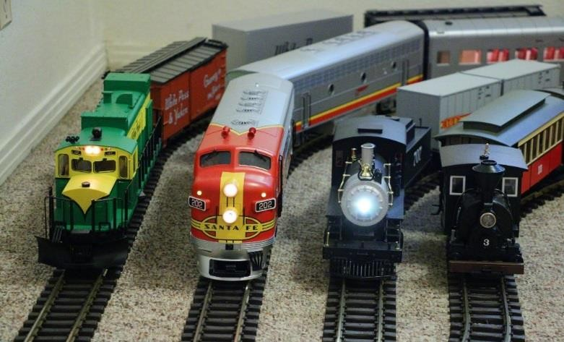



Continuous Delivery: Serial Updates
No upgrades: less disruption, faster adoption monthly only patch updates from Siebel IP 2018
Multiple parallel codelines
Numbering is [IP Year].[1-19]
Single cumulative codeline
Numbering is Year.Month

Slide 25








Siebel Roadmap – Continuous Innovation & Delivery
2013-15 2016 2017 2018 2019 2020 2021
Applications Unlimited
2022
2023
NO END DATE
UX & UI
Partner,
Customer Apps Usage Pattern Tracking
DevOps Monthly Updates Docker Containers Gateway Clusters
Big Data/AI
Auto-charting
Task prescription Cross-industry IoT
Decentralization Distributed Siebel data, computing, orchestration
UX & UI
Autonomous
CX
Agile Upgrades &
Development,
Open UI & RWD,
Mobility
RESTful APIs
DevOps
DevOps/AI* Mobile-app generation Chatbots, Voice, Data Visualization
Distributed AI-ML
Blockchain, …
Cloud-Ready
Big Data/AI
Edge intelligence Federated data and tasks
Zero downtime Auto Test Automation
*0-12 months
Digital: User
Digital: Developer, Administrator
User (Mobile)
Intelligent
Mesh

Slide 26

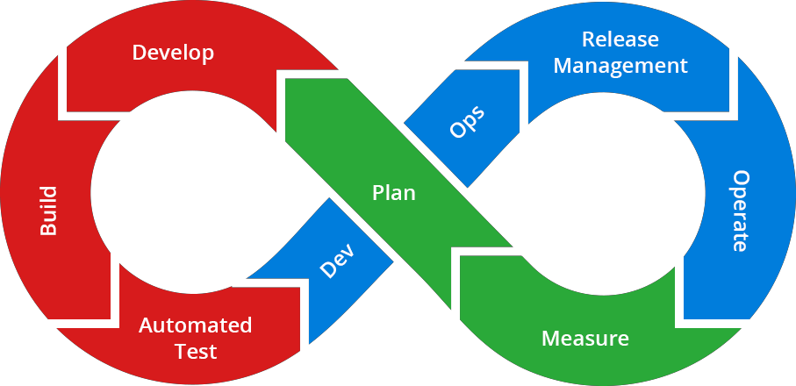





Near-Zero Downtime
Continuous Innovation & Delivery (CI-CD), Industry Standards
Simplified Dev-2-Prod & Dev-2-Test via browser- based application
Siebel Approval Manager
Parallel Development
Siebel Composer
Outbound REST, Open API
CHEF on Oracle Cloud (IP16 internal) Siebel Instance in < 1 hr
Roadmap & Statement of Direction (SOD)
Dynamic Gateway
Unified User, REST &
SOAP interface
High-availability scale up/down, dynamic enterprise registry
Based on CAB
input
Docker Containers
Jenkins DevOps pipeline
Enterprise Manager
Usage-Pattern Tracking
Built-in Test Automation
Siebel Test Execution Jenkins Plugin

Slide 27



Innovation Highlights
Innovations across persons
Users
Developers
Administrators
Sky Blue Theme
Multitasking
Mobile UI Enhancements
Live Experience Integration
Applet/View Layout Editor
Task Editor
Script Editor/Debugger
Workflow Preview
SMC Administration
Workspace Rollback to Last Good Version
Asynchronous Migration

Slide 28











Flight Path to Digital Transformation
1. Private Cloud (On Premise)
2. Platform (IaaS/Paas)
3. Hybrid CX (SaaS)
Siebel on-Premise
Open UI UX & Mobility
Continuous innovation &
delivery for business agility
Process Automation -> Autonomous CX
Siebel on Cloud
Oracle Cloud Infrastructure
Migration Tooling
Managed Services (OMCS)
@Customer, Cloud Machine
Siebel + CX applications + Adaptive Intelligence
Hub-and-spoke Integration
Cloud Services (ICS)
Customer 2 Cloud option (unused licenses)

Slide 29
Lifetime Support for Existing Oracle Applications*
Enabling customers to confidently maximize and/or expand their existing Oracle application investments with ample time for future planning by providing assurance in Oracle’s commitment to support its existing applications via a stable and predictable long term support policy.
Premier Support “through at least” 2040
Rolling 10 years of Premier Support
Now
FuturFeuturFeuturFeuturFeuturFeuturFeuturFeuturFeuturFeuturFeuturFeuturFeuture
Premier Support
2020 2025 2030 … 20XX
At Least a Decade of Oracle Premier Support
2015

Slide 30

AUTONOMOUS CRM
The automation imperative continues to require CRM systems to focus on superior customer experience. From the manual digital phase (self-service, mobile) to the increasingly data intensive and automated (Social, IoT), we are being driven to position Siebel CRM on the combination of usage data with pre-built processes. The automation of processes is now manifest in the long-term roadmap for Siebel CRM.
Multiple use cases from the availability of structured process data:
Business Process Discovery
Analyzing process data for process mining
Creating user training content
Producing iHelp content
Generating tasks for the Task Based UI
Constructing task-based flows and automatically creating microservices from recorded processes
Business Process Automation
33

Slide 31

Test Automation
In order to automate tests that leverage the Siebel CRM REST interface, ‘REST Assured’ tools will be supported with a Keyword-driven framework. The framework will be enhanced to execute REST API test scripts and bring back test results into Siebel CRM. The enhancements will allow interlacing REST API calls among UI Test Scripts, and build independent REST API based Test Scripts.
This extends Atlanta 311 City Siebel CRM Test Automation capabilities to include REST test scripts, and saves manual efforts on separate execution and integrating test results.

Slide 32
END

